Slide 1
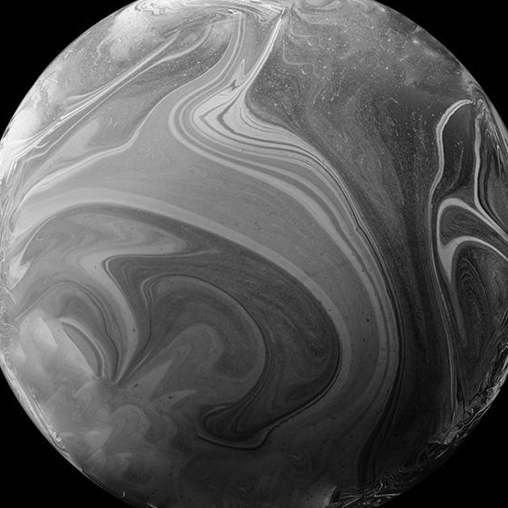
TWINKLE TWINKLE LITTLE STAR
INTERGALATIC Team

Slide 2

Dynamic Stars
The stars above are constantly changing, but usually these changes are too slow or too faint for the eye to see.

Slide 3
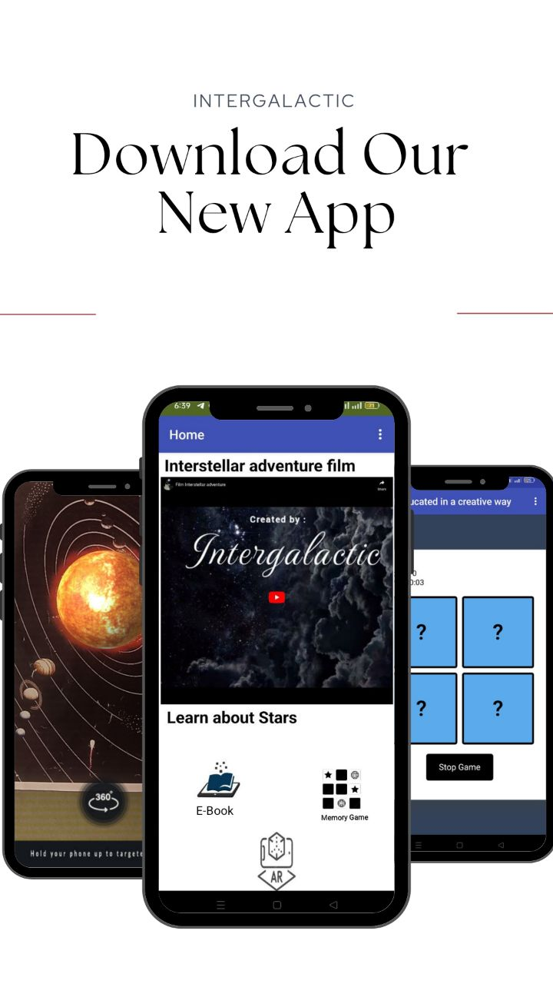
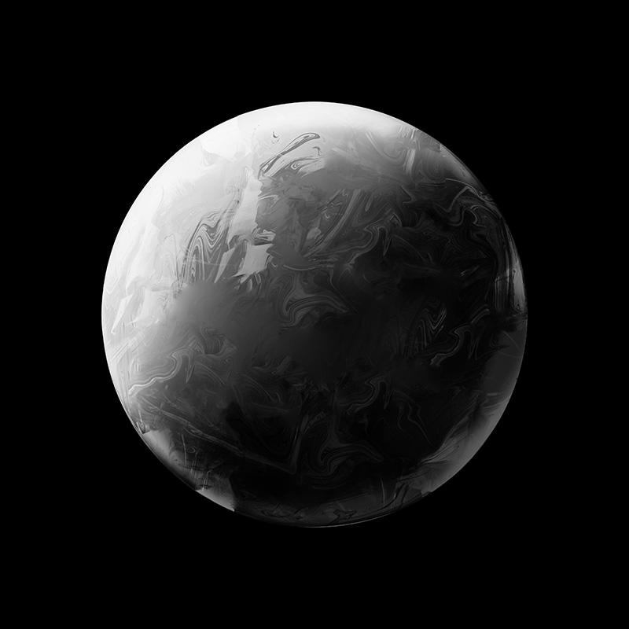
OUR MOBILE APPLICATION
01
02
03
04
Augmanted Reaility
Scientific Film
E-Book
Memory Game

Slide 4
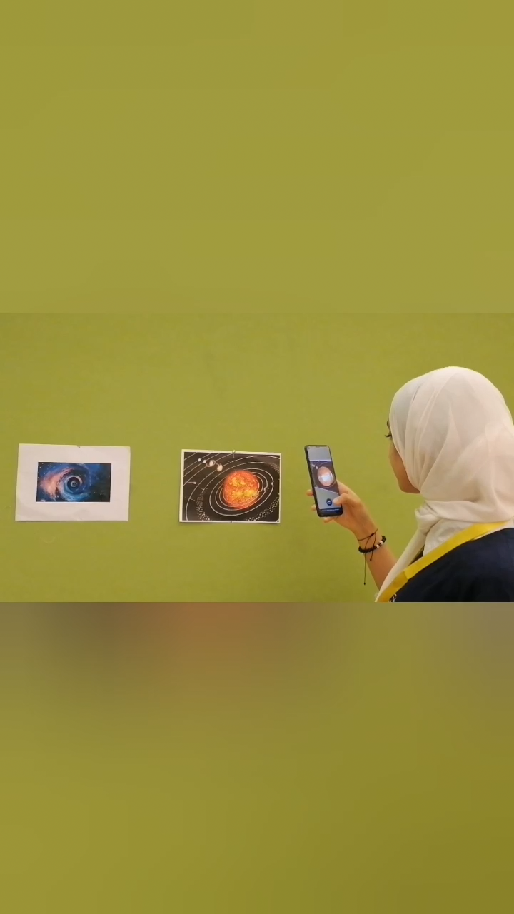
Augmanted Reaility < AR >
That shows the stars as in the real world !
We found it great to add this technology
in the NASA Museum because it makes
the visitor see the truth of what is in front of him

Slide 5
Scientific Film
Talk about the dynamic & static stars "Intergalactic adventure".

Slide 6
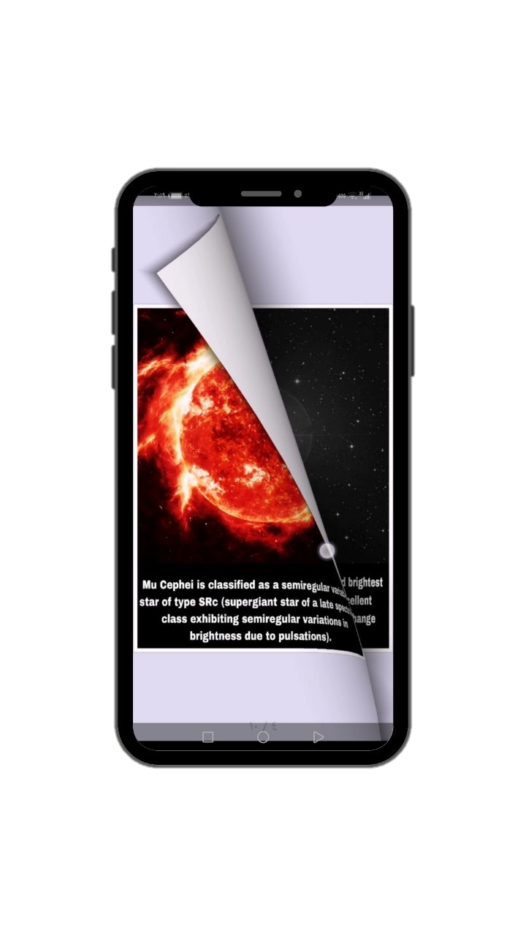
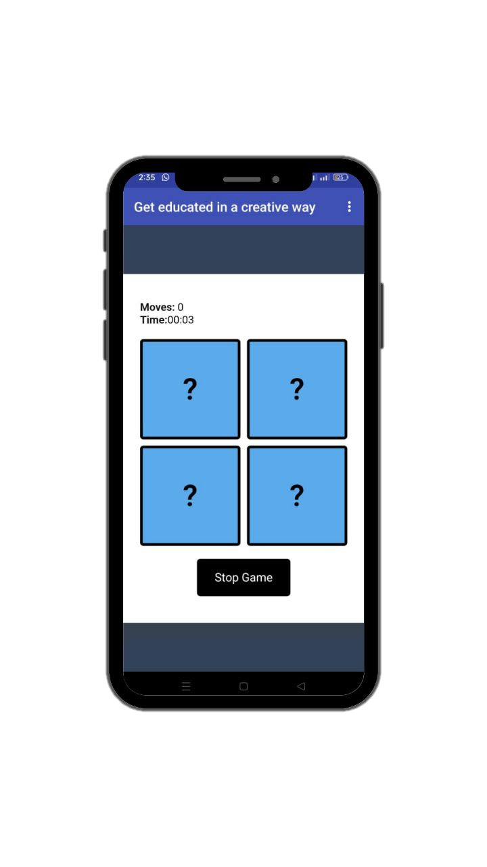
E-BOOK
MEMORY
GAME
That tells a story about reality of the brightness of the stars.
That keeps the mind active in all stages of life.

Slide 7

Recourses
• https://sci.esa.int/web/hubble/-/variable-stars-in-hubble-s-sky
• https://starchild.gsfc.nasa.gov/docs/StarChild/questions/cepheids.html
• https://heasarc.gsfc.nasa.gov/W3Browse/all/gcvs.html
• https://imagine.gsfc.nasa.gov/science/objects/cataclysmic_variables.html
• https://www.cosmos.esa.int/web/gaia/data-release-3

